Slide 1
Data Types in Java
Rajasekaran S
Assistant Professor,
Department of Information Technology,
KGiSL Institute of Technology,
email: proffraja@gmail.com

Slide 2
Data Types Supported By Java
Data Type
Integer
Float
Character
Boolean
int
float
short
double
long
char
bool
byte

Slide 3
Integer
Type | Storage Required | Range
byte | 1 byte | -128 to 127
short | 2 bytes | -32768 to 32767
int | 4 bytes | -2147483648 to 2147483647
long | 8 bytes | -9223372036854775808 to 9223372036854775807
http://bit.ly/2m0IoFz

Slide 4
Decimal
Type | Storage Required | Range
float | 8 byte | approximately ±3.40282347E+38F (6-7 significant decimal digits)
double | 16 bytes | approximately ±1.797693134862315 0E+308 (15 significant decimal digits)
http://bit.ly/2KJUIZF

Slide 5
Character
Type | Storage Required | Range
char | 2 bytes | 0 to 65,536 (unsigned)
Boolean
Type | Storage Required | Range
bool | - | true or false

Slide 6
Escape Sequence
Escape Sequence | Name
\n | New Line
\b | Backspace
\t | Tab
\r | Carriage Return
\” | Double Quote
\’ | Single Quote
\\ | Backslash

Slide 7
Variables in Java
All variables are statically typed.
You can’t use the variable which is not declared.

Slide 8
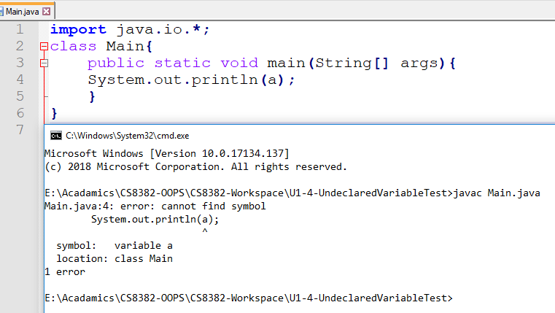
Demo of Undeclared Variable Usage

Slide 9
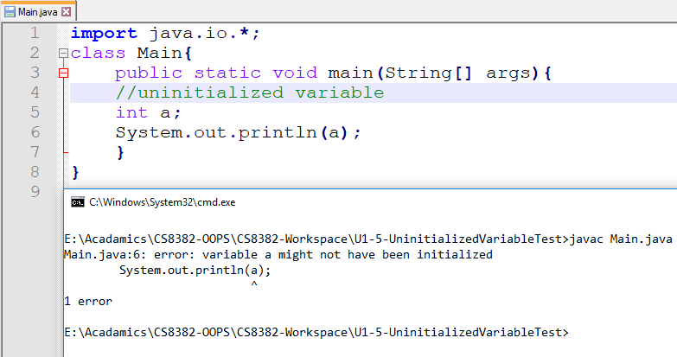
Demo of Uninitialized Variable Usage

Slide 10
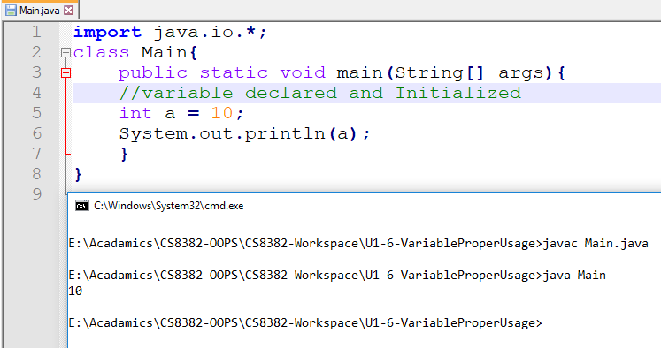
Demo of Proper use of Variable

